Slide 1
Emerging Trends, Technologies, and Applications

Slide 2
Learning Outcomes
Summarize new trends in software and service distribution
Describe virtual reality components and applications
Discuss uses of radio frequency identification
Explain quick response codes

Slide 3
Learning Outcomes
Summarize new uses of biometrics
Describe new trends in networking, including grid, utility, and cloud computing
Discuss uses of nanotechnology

Slide 4
Trends in Software and Service Distribution
Pull technology
User states a need before getting information
Entering a URL in a Web browser to go to a certain website
Push technology (Webcasting)
Web server delivers information to users who have signed up for this service
Supported by many Web browsers
Delivers content to users automatically at set intervals or when a new event occurs

Slide 5
Trends in Software and Service Distribution
Streamlines the process of users getting software updates and updated content
Benefits vendors by keeping in constant touch with users creating customer loyalty
Examples
Microsoft direct push (AT&T)
Apple push notification
Blackberry

Slide 6
Trends in Software and Service Distribution
Application service providers (ASPs)
Provides access to software or services for a fee
Software as a service (SaaS)
Delivers software to users for a fee
For temporary or long-term use
Offers the recent version of the software
Allows users to save all application data on the asp’s server for the software and data to be portable
Known as on-demand software

Slide 7
Virtual Reality (VR)
Uses computer-generated, three-dimensional images to create the illusion of interaction in a real-world environment
Simulation: Giving objects in a VR environment texture and shading for a 3D appearance
Interaction: Enabling users to act on objects in a VR environment
Immersion: Giving users the feeling of being part of an environment by using special hardware and software

Slide 8
Virtual Reality (VR)
Telepresence: Giving users the sense that they are in another location and can manipulate objects as though in reality
Full-body immersion: Allowing users to move around freely by combining interactive environments with cameras, monitors, and other devices
Networked communication: Allowing users in different locations to interact and manipulate the same world at the same time by connecting two or more virtual worlds

Slide 9
Types of Virtual Environments
Egocentric environment
User is totally immersed in the VR world
Technologies used with the environment
Head-mounted display (HMD)
Virtual retinal display (VRD)
Exocentric environment
User is given a window view
Data is rendered in 3D, but users can only view it on screen
Users can not interact with objects, as in an egocentric environment

Slide 10
Types of Virtual Environments
Egocentric environment
User is totally immersed in the VR world
Technologies used with the environment
Head-mounted display (HMD)
Virtual retinal display (VRD)
Exocentric environment
User is given a window view
Data is rendered in 3D, but users can only view it on screen
Users can not interact with objects, as in an egocentric environment

Slide 11
Components of a Virtual Reality System
Visual and aural systems
Manual control for navigation
Central coordinating processor and software system
Walker
Allows users to see and hear the virtual world
Allows the user to navigate in the VR environment and control various objects
Generates and manipulates high quality graphics in real time, needs a very fast processor
Input device captures and records movements of the user’s feet as the user walks or turns in different directions

Slide 12
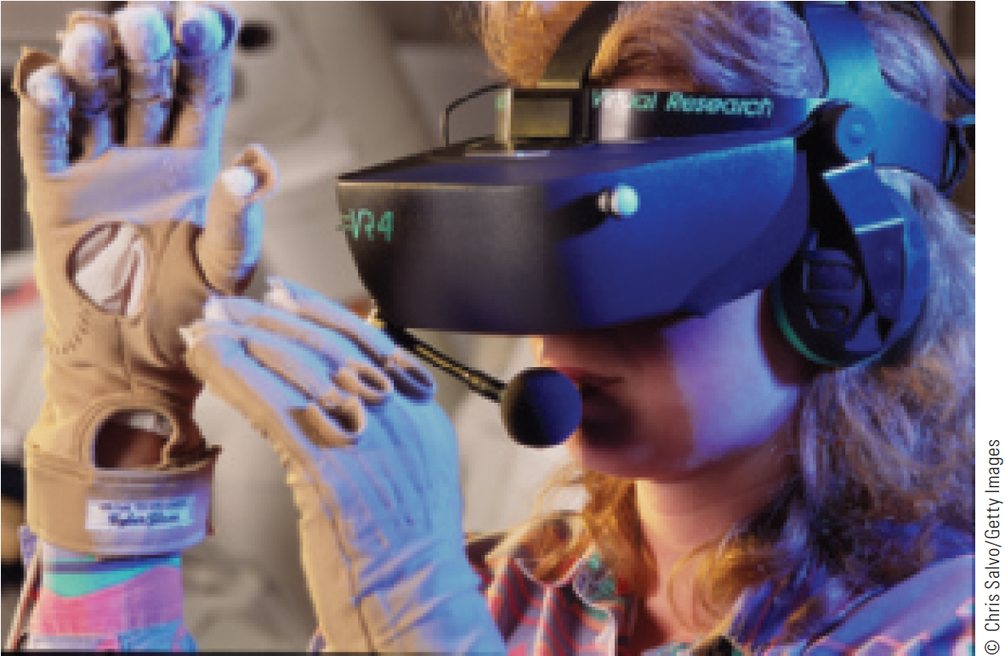
Components of a Virtual Reality System

Slide 13
Cave Automatic Virtual Environment (CAVE)
Consists of a cube-shaped room in which the walls are rear-projection screens
Holographic devices that create, capture, and display images in true 3-D form
Used for research in archaeology, architecture, engineering, geology, and physics
Used by engineering companies to improve product design and development

Slide 14
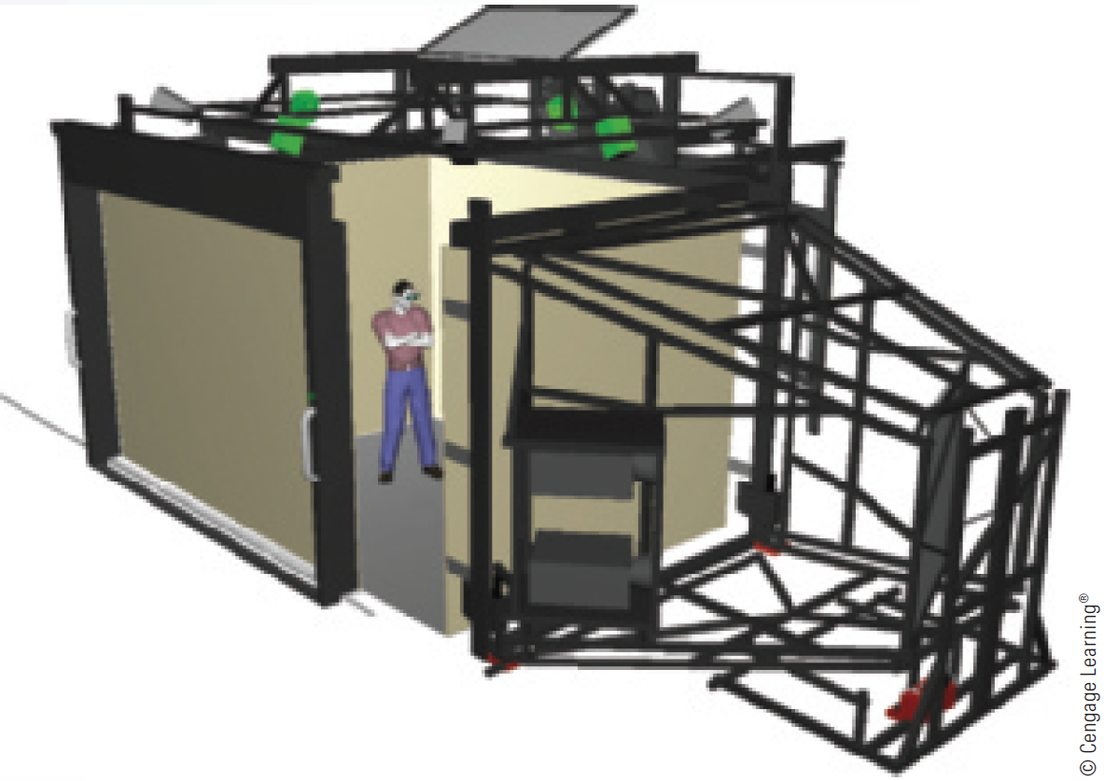
Cave Automatic Virtual Environment (CAVE)

Slide 15
Virtual Reality Applications
Military flight simulations
Medicine for bloodless surgery
Entertainment industry in games and theaters
Current business applications
Assistance for the disabled
Architectural design
Education
Flight simulation
Videoconferencing and group support systems

Slide 16
Obstacles in Using VR Systems
Lack of fiber-optic cables to carry the data transmissions needed for a VR environment capable of re-creating a conference
Confusion between the VR environment and the real environment
Mobility and other problems with HMDs
Difficulty representing sound
Need for additional computing power

Slide 17
Virtual Worlds
Simulated environment designed for users to interact via avatars
Avatar: 2D or 3D graphical representation of a person in the virtual world
Used for gaming, social networking, and entertainment
Used by organizations to conduct a variety of business activities
Marketing and sales, product development, recruiting, and team meetings

Slide 18
Widely Used Virtual Worlds
Active Worlds
Club Penguin
EGO
Entropia Universe
Habbo
Runescape
Second Life

Slide 19
Radio Frequency Identification (RFID) Tag
Small electronic device consisting of a small chip and an antenna
Provides a unique identification for the card or the object carrying the tag
Types
Passive: Include no internal power supply, can be very small
Active: Include an internal power source and are more reliable than passive tags
Embedded in a sticker or under the skin

Slide 20
Radio Frequency Identification (RFID) Tag
Technical problems
Signals from multiple readers can overlap
Signals can be jammed or disrupted
Difficult to remove
Privacy and security issues
Ability to read a tag’s contents after an item has left the store
Tags being read without customer’s knowledge
Tags with unique serial numbers being linked to credit card numbers

Slide 21
RFID Applications
Category | Examples
Tracking and identification | Railway cars and shipping containers, livestock and pets, supply-chain management
Payment and stored-value systems | Electronic toll systems, contactless credit cards, subway and bus passes
Access control | Building access cards, ski-lift passes, car ignition systems
Anticounterfeiting | Casino tokens, high-denomination currency notes, luxury goods, prescription drugs
Health care | Tracking medical tools and patients, monitoring patient data

Slide 22
Quick Response Code
Matrix barcode, black modules arranged in a square pattern on a white background
Features
High storage capacity
Small printout size
Dirt and dust resistance
Readable from any direction
Compatible with the Japanese character set

Slide 23
Biometrics
Offer a high degree of accuracy that is not possible with other security measures
Used in e-commerce and banking by phone
Using voice synthesizers and customers’ voices as the biometric element that identifies them remotely

Slide 24
Current and Future Applications of Biometrics
ATM, credit, and debit cards
Network and computer login security
Web page security
Voting
Employee time clocks
Member identification in sport clubs
Airport security and fast check-in
Passports and highly secured government ID cards
Sporting events
Cell phones and smart cards

Slide 25
Wireless Fidelity (Wi-fi)
Information can be transmitted over short distances in the form of radio waves
Connects computers, mobile phones and smart phones, MP3 players, PDAs, and game consoles to the internet
Connections are easy to set up and have fast data transfer rates
Offers mobility and flexibility

Slide 26
Wireless Fidelity (Wi-fi)
Disadvantages
Susceptible to interference from other devices and to being intercepted which raises security concerns
Lack of support for high-quality media streaming

Slide 27
Worldwide Interoperability for Microwave Access (WiMAX)
Broadband wireless technology based on the IEEE 802.16 standards
Designed for wireless metropolitan area networks
Includes a range of about 30 miles for fixed stations; 3-10 miles for mobile stations
Fast and easy to install
Enables devices using same frequency to communicate

Slide 28
Worldwide Interoperability for Microwave Access (WiMAX)
Disadvantages
Interference from other wireless devices
High costs
Interruptions from weather conditions
Requires a lot of power
Transmission speed decreases when bandwidth is shared among users

Slide 29
Bluetooth
Wireless technology for transferring data over short distances for fixed and mobile devices
Used to create a personal area network (PAN)
Uses a radio technology called Frequency Hopping Spread Spectrum (FHSS)

Slide 30
Bluetooth
Used to connect devices such as computers, GPSs, mobile phones, laptops, printers, and digital cameras
Has no line-of-sight limitations
Susceptible to interception

Slide 31
Grid Computing
Involves combining the processing powers of various computers
Allows users to make use of other computers’ resources to solve problems with this configuration involving:
Large-scale, complex calculations
Problems that a single computer is not capable of solving in a timely manner
Each participant in a grid is referred to as a node

Slide 32
Grid Computing
Processing on overused nodes can be switched to idle servers and even desktop systems
Used bioinformatics, oil and gas drilling, and financial applications
Advantages
Improved reliability
Parallel processing nature
Scalability

Slide 33
Utility (On-Demand) Computing
Provision of IT services on demand
Users pay for computing or storage resources on an as-needed basis
Advantages
Convenience
Cost savings
Drawbacks
Privacy
Security

Slide 34
Cloud Computing
Incorporates many recent technologies under one platform
SaaS model, web 2.0, grid computing, and utility computing
Includes components in the form of:
Infrastructure as a service (IaaS)
Platform as a service (PaaS)
Software as a service (SaaS)

Slide 35
Cloud Computing
Includes many of the advantages and disadvantages of distributed computing
Users can request services, applications, and storage
Services require a fee although some are free

Slide 36
Public, Private, Hybrid, and Community Clouds: Which One to Choose
Organizations choose based on security needs and level of involvement IT managers require
Public
Users connect with an off-site infrastructure over the internet
Private
Services and the infrastructure are run on a private network

Slide 37
Public, Private, Hybrid, and Community Clouds: Which One to Choose
Hybrid
Chosen by organizations that operate on both private and public data
Collection of at least one private and at least one public cloud
Community
Cloud infrastructure is designed for exclusive use by a specific community of users from organizations with common concerns

Slide 38
Cloud Computing Security
Organization that uses cloud computing should:
Provide end-user education
Force software updates
Work with the cloud computing provider to spot unusual activities

Slide 39
Cloud Computing Security Risks
Privileged user access
Regulatory compliance
Data location
Data segregation
Recovery
Investigative support
Long-term viability

Slide 40
Nanotechnology
Incorporates techniques that involve the structure and composition of materials on a nanoscale
Plays a role in the areas of:
Energy
Information and communication
Heavy industry
Nanomaterials: Consumer goods incorporating nanotechnology

